Slide 1
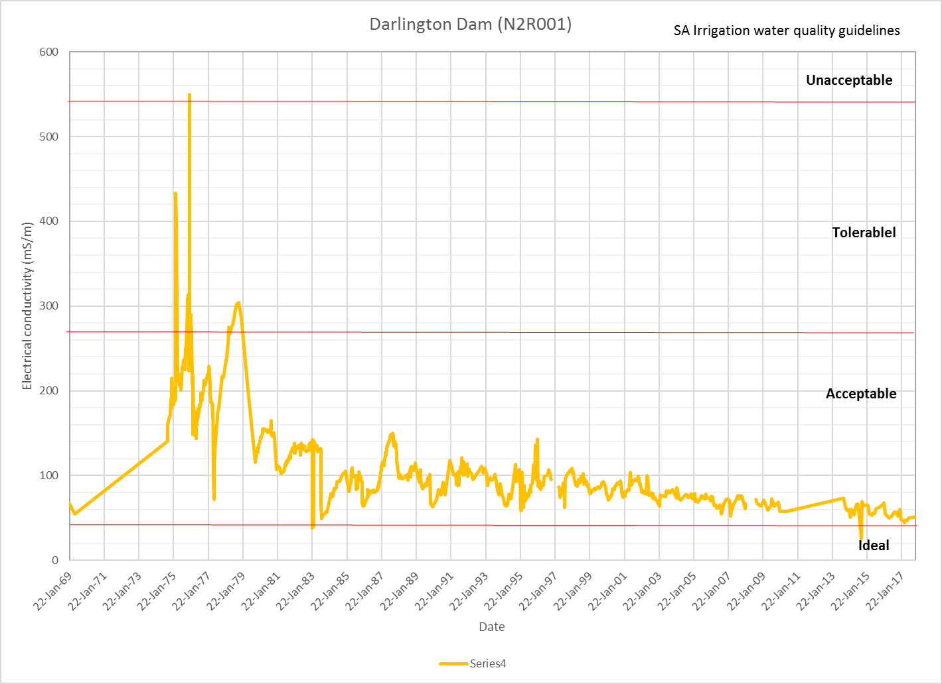

Slide 2
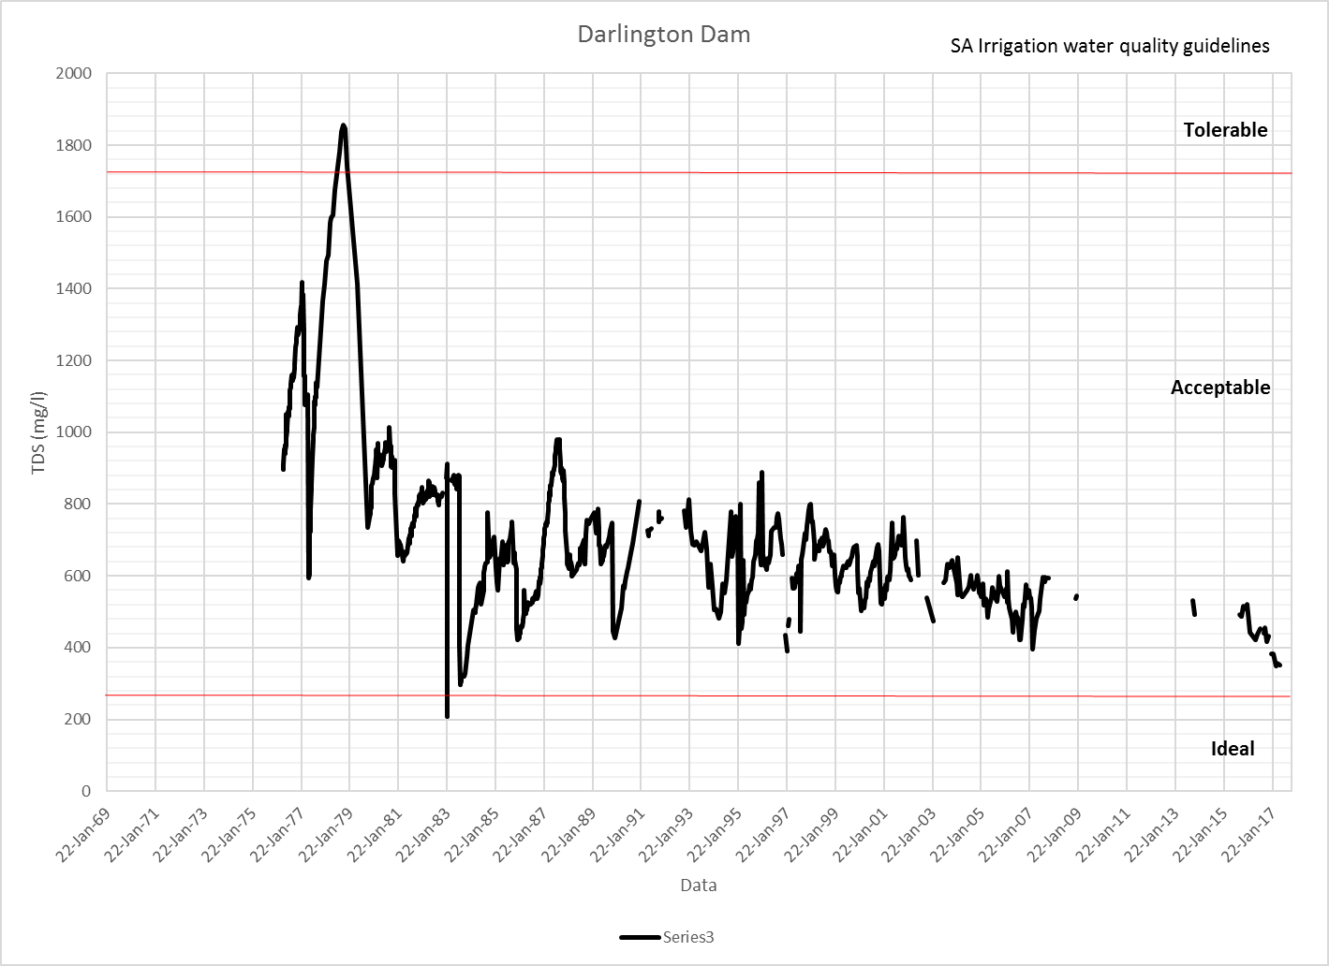

Slide 3
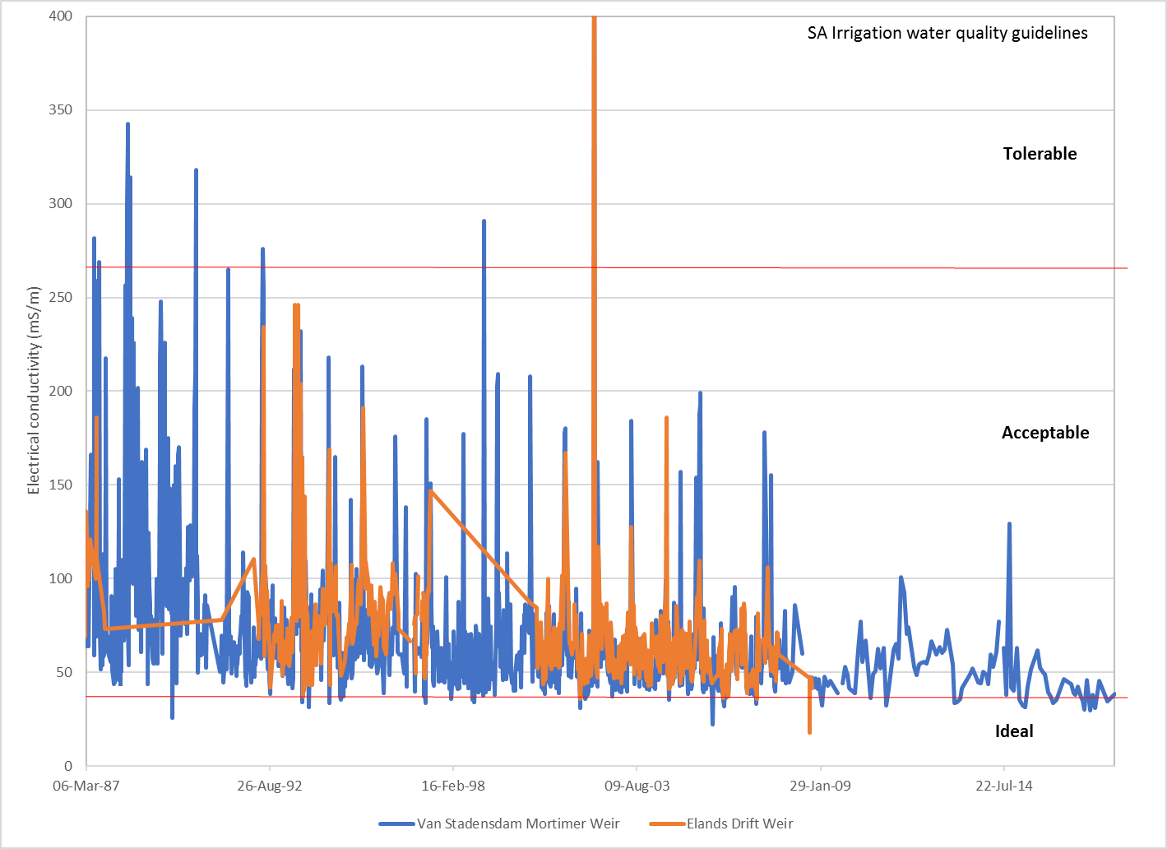
Great Fish River salinity

Slide 4
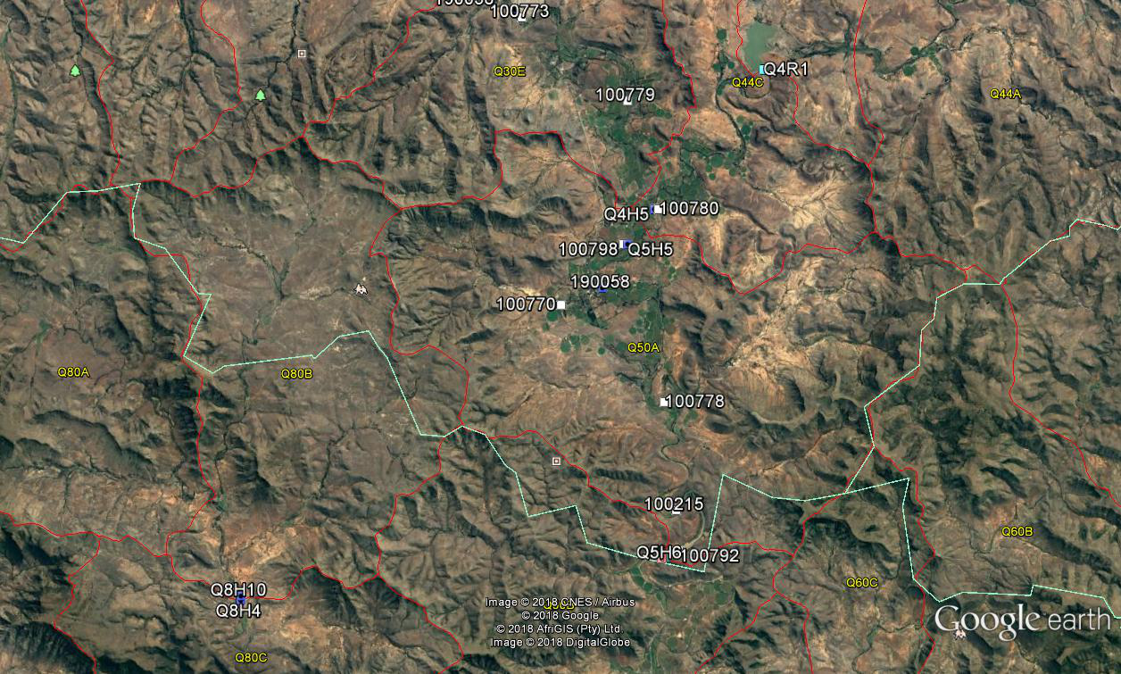
Lake Arthur
van Stadensdam Mortimer Weir
Elands Drift Dam

